Slide 1
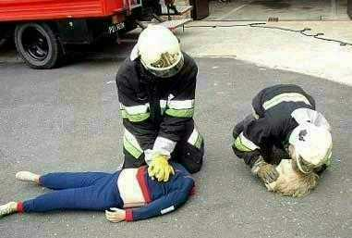
When is Dead Really Dead?
Mike McEvoy, PhD, REMT-P, RN, CCRN
EMS Coordinator, Saratoga County, NY
EMS Director - NYS Association of Fire Chiefs
Professor Emeritus - Cardiothoracic Surgery, Albany Medical College
EMS Editor – Fire Engineering magazine

Slide 2
Disclosures
I have no financial relationships to disclose.
I am the EMS technical editor for Fire Engineering magazine.
I do not intend to discuss any unlabeled or unapproved uses of drugs or products.

Slide 3
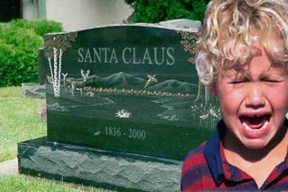
Not Suitable for Small Children

Slide 4
www.mikemcevoy.com

Slide 5
Outline
EMS: Bringing out the dead
Involvement in field pronouncements
Problems
Criteria for death
Why we screw it up
How to stay out of hot water
Standard practice for field pronouncement
Dealing with difficult cases

Slide 6
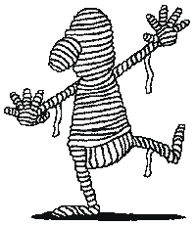
How many?
Pronounce death?
Declare death?
Honor DNR?
Decide not to initiate resuscitation?
Stop resuscitation someone else started?
Terminate field resuscitation?

Slide 7
Case # 1
R-10, A-15 sent to MVC w/ entrapment
PD @ scene report single vehicle into concrete bridge abutment, lone occupant appears deceased
R-10 EMT-FF’s find approx 16 yo ♂ lying across front floor of compact car
Obvious bilat open femur fx
Rigid, distended belly
Blood with apparent CSF from both ears
No observable resps, no palpable pulses

Slide 8
Case # 1 (continued…)
R-10 officer cancels ambulance
Advises police that driver is dead
Requests Medical Examiner to scene
ME arrives one hour later
Finds patient breathing, barely palpable pulse
EMS recalled
Patient resuscitated, xpt to trauma center
Dies 2 days later from massive head inj
Family calls news media, files complaint with State EMS office

Slide 9
Case #2
EMS dispatched to reported obvious death in low income housing project
Arriving medics find elderly ♀ supine on kitchen floor
Apparent advanced stage of decomposition
Large areas of skin grotesquely peeled from arms and torso
Overwhelming foul odor throughout apartment
Coroner contacted to remove body

Slide 10
Case #2 (continued…)
Later that evening, hospital morgue attendant summon resuscitation team
Supposedly deceased patient moaning for help
Patient admitted to ICU
Massive Streptococcus pyrogenes (“flesh eating”) bacterial skin infection
Dies 3 days later
CNN, national news media prominently carry the story

Slide 11
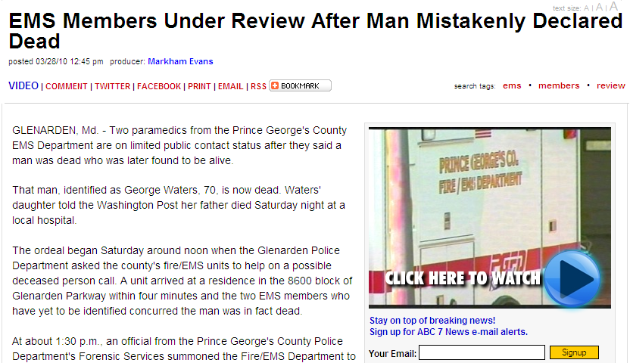
Isolated Events?

Slide 12
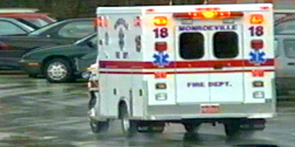
Death
2.4 million Americans die annually
Most deaths are in hospitals (61%)
Or nursing homes (17%)
Smallest # die in community (22%)
Why does EMS lead news stories on mistaken pronouncements?

Slide 13
Formal Training
Physicians are taught & practice death pronouncement
EMS is not
Your name here?

Slide 14
What Do People Fear?
Public speaking
Live burial

Slide 15
Fear of live burial
1800’s – coffins equipped with rescue devices
1899 – NY State enacted legislation requiring a physician pronounce death
1968 – Uniform Anatomic Gift Act authorized organ donation: worries about premature pronouncements

Slide 16
Premature Pronouncement
1968 – Harvard Ad Hoc Committee on Brain Death published definition of “irreversible coma”:
Unresponsive – no awareness/response to external or painful stimuli
No movement or breathing
No reflexes – fixed & dilated pupils, no eye movement when turned or cold water injected into ear, no DTRs
Currently called “brain death”

Slide 17
1981:
170+ pages
Became death criteria for all 50 states
Basis for UDDA (Uniform Determination of Death Act)

Slide 18
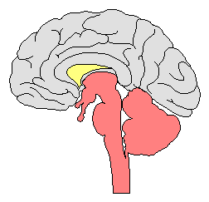
Why?
Technology
Pulselessness and apnea no longer identified death:
Mechanical ventilation
Artificial circulatory support
ICU patients who would never recover could be kept “alive” indefinitely
Main goal = standardize criteria for irreversible loss of all brain function

Slide 19
Brain Death
EMS doesn’t pronounce brain death
Neither does a lone doc, NP, or PA
Such decisions require:
Time
Specialized testing
Brain specialists such as neurologists

Slide 20
Who does EMS pronounce?
People we find dead
People we cease resuscitating
So, what’s the book say?

Slide 21
Dead=irreversible cessation
“An individual with irreversible cessation of circulatory and respiratory function is dead. Cessation is recognized by an appropriate clinical exam,” whereas, “Irreversibility is recognized by persistent cessation of functions for an appropriate period of observation and/or trial of therapy.” (p. 133)

Slide 22
Appropriate Clinical Exam

Slide 23
“Appropriate Clinical Exam”
ABSOLUTE MINIMUM REQUIREMENTS:
General appearance of body
No response to verbal/tactile stimulation
No pupillary light reflex (pupils fixed and dilated)
Absence of breath sounds
Absence of heart sounds

Slide 24
“Appropriate Clinical Exam”
Deep, painful stimuli inappropriate
Nipple twisting, sternal rubs…
Some suggest testing corneal reflexes
Duplicates pupillary reaction to light; both require some intact brainstem function
When more sophisticated monitors are available, they should be used!

Slide 25
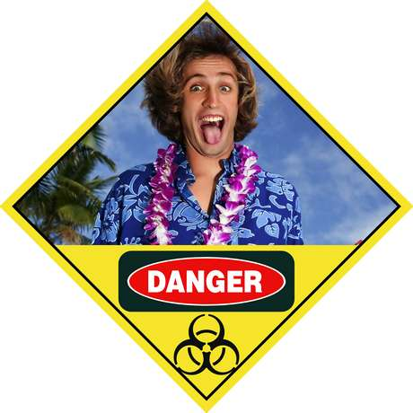
Death Traps: Red Flags
Patients found dead
Death not observed or expected
Death was sudden
Resuscitation not provided

Slide 26
Death Traps
Massive internal injuries
Lack invasive testing to confirm
Massive head trauma or GSW
Often lack experience with these injuries
Isolated fatal injuries
Organ donor potential – attempt resus?
Drug overdose, hypothermia, massive infections, total paralysis, hepatic coma, drowning…

Slide 27
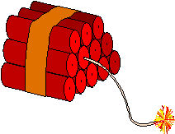
Death Traps
Pediatric patients
Drowning
Less than 2 hours may be survivable
Hypothermia
Cannot pronounce until > 90°F
LVAS (artificial heart) patients

Slide 28
Left Ventricular Assist Systems
LVAS, or “artificial heart”
Earlier devices were air driven, pulsatile pumps
Next gen devices are centrifugal
Magnetically levitated impeller propels blood
Non-pulsatile flow

Slide 29
Centrifugal LVAS
The patient has no pulse!

Slide 30
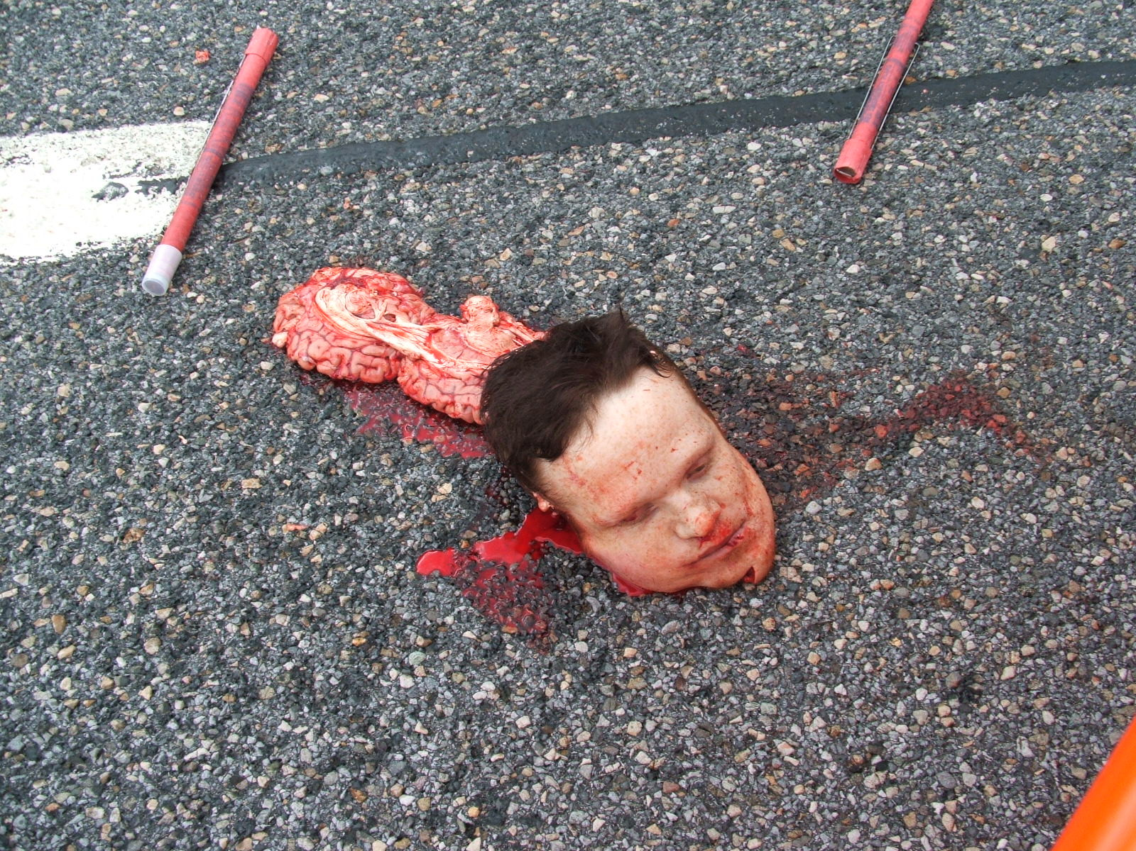
Irreversibility….

Slide 31
the Lazarus Phenomonem
Autoresuscitation (AR)
Spontaneous ROSC after failed resuscitation attempt
Uncommon, theorized due to:
Delayed effects of resuscitation meds
Intrathoracic pressure change once PPV discontinued
Warrants prolonged observation

Slide 32
AR: Is He Dead Jim?
Never reported without CPR
Unless patient not properly pronounced
No reported cases in children
No single AR >7 minutes following termination of CPR
When proper times were recorded
Current best practice is 10 minute observation following termination
Hornby K, Crit Care Med, 2010, 38: 1246-1253

Slide 33
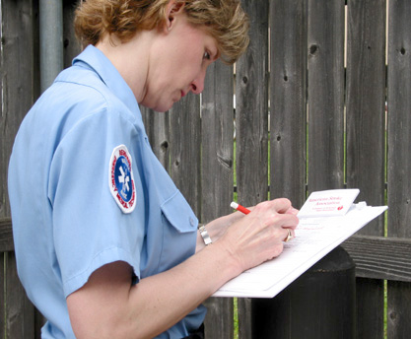
Death Documentation
Describe your exam
Include time of exam (this is time of death)

Slide 34
Clinical Exam for Death
No response to verbal or tactile stimulation
No pupillary light reflex (pupils fixed and dilated)
Absence of breath sounds
Absence of heart sounds

Slide 35
Death Documentation
Describe your exam
Include time of exam (this is time of death)
Location/position where found
Physical condition of body
Significant medical hx or trauma
Conditions precluding resus
Any medical control contact
Person body left in custody of

Slide 36
Employ every available tool
ALS if available
Record 15 second EKG in 2 leads
Attach AED if no ALS available
Leave electrodes/pads on the body
Use ultrasound, stethoscope, etc.
Make certain that the most senior EMS provider available confirms the death

Slide 37
Death Traps
You will never find something that you don’t look for!
Every mistaken pronouncement:
Jumping to conclusions
Lack of detailed search for any sign of life
Don’t be dead wrong; be DEAD RIGHT

